Slide 1

SafetyGurad – Watchdog Software
Elisa Systems WG
Presented by
Sathishkumar Duraisamy, SDuraiEngineer
Moderated by
Philipp Ahmann, ETAS GmbH

Slide 2
SafetyGuard
A reusable, safety-oriented Linux supervision middleware.
Work in Progress - License: CC-BY-4.0

Slide 3
SafetyGuard Goals
Zero-copy IPC
Deterministic timing
Fault detection + watchdog
Restart / recovery
Rust-native core and C ABI for language-agnostic producers
Scalable toward industrial / automotive-style safety
Work in Progress - License: CC-BY-4.0

Slide 4
Existing Solution
Existing solution : processwatchdog
In multi-app embedded systems:
  Polling wastes CPU
  Pipes/sockets add latency + copies
Need:
  A system that is: Fast + Predictable + Recoverable
Work in Progress - License: CC-BY-4.0

Slide 5
Architectural Principles
Control Plane
UNIX socket registration + FD handoff
Data Plane
Shared Memory (mmap / memfd) + SPSC Ring Buffer
Signal Plane
eventfd + epoll (Like mosquitto broker, where mosquitto works over tcp socket)
Safety Plane
Monitor + timerfd watchdog + SafeInstrument + SafeAction
(Heartbeat + Memory)
Work in Progress - License: CC-BY-4.0

Slide 6
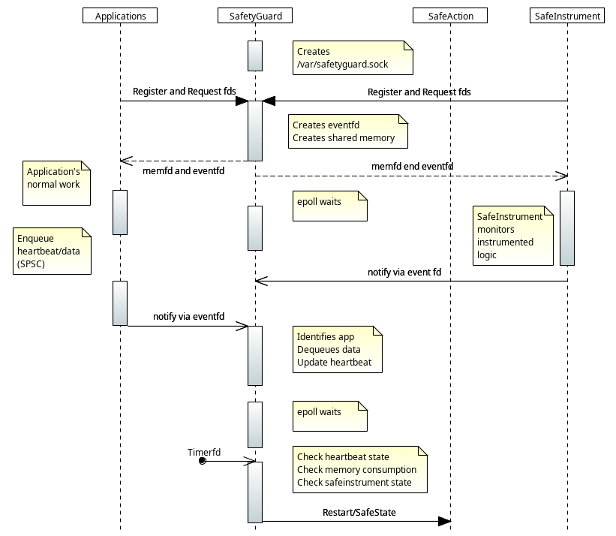
High-Level Architecture Diagram
Work in Progress - License: CC-BY-4.0

Slide 7
SAFE State and Safe Instrument
Safe State and Safe Instrument are application specific.
API will be provided.
One can develop required domain specific safe state application and safe instrument application.
As part of AGL, we will develop reference safe state and safe instrument apps.
Work in Progress - License: CC-BY-4.0

Slide 8
Health Monitoring
Heartbeat
Each app periodically sends: Timestamp and Status
Watchdog
SafeMonitor uses timerfd to check: now - last_heartbeat > timeout
Response
Restart the app or container
Enter degraded mode ( When one or more apps timeout and restarted. Back to normal, when all apps does sends normal heartbeat)
Enter safe state (Goal not restart the system, but to move to safesate, as determined by domain)
Restart system if required (If safe state app sends response to restart)
Work in Progress - License: CC-BY-4.0

Slide 9
Application start-up flow (Control Plane)
App connects to SafetyGuard
App requests to SafetyGuard with AppName and its version
SafetyGuard returns (per app exclusive): (why? No named file in filesystem)
    eventfd
    shared memory handle/name (Why? Other IPC copies data)
App initializes producer API
Key benefits:
  Dynamic registration, no hardcoded IPC resources
Work in Progress - License: CC-BY-4.0

Slide 10
Why SPSC?
Advantages
Single Producer / Single Consumer simplicity
Lock-free
No mutex overhead
Fixed-size deterministic memory
Strong fit for safety arguments
Talk: https://www.youtube.com/watch?v=K3P_Lmq6pw0
Work in Progress - License: CC-BY-4.0

Slide 11
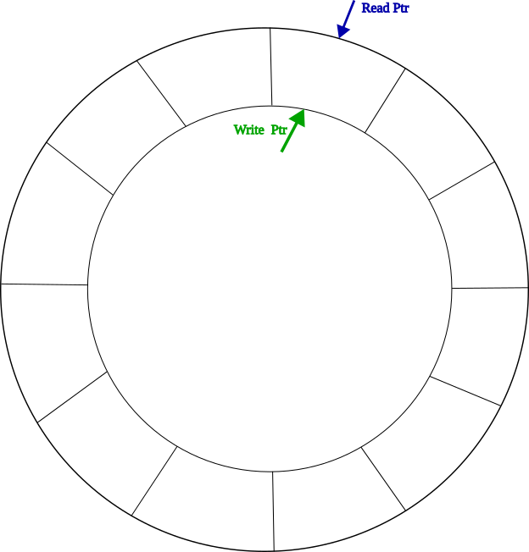
Runtime Data Flow (Fast Path)
Producer App
  Write Message to SPSC Queue
  Notify eventfd
SafetyGuard
  epoll wakeup
  Identify source app
  Dequeue all messages
  Process health / metrics / errors
Work in Progress - License: CC-BY-4.0

Slide 12
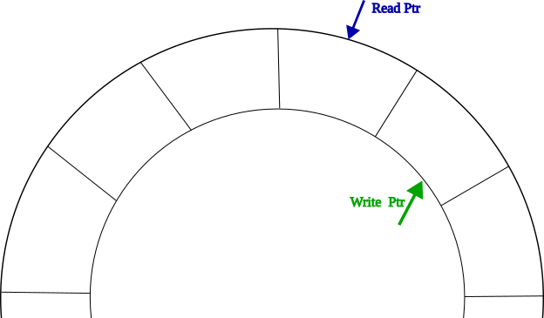
Runtime Data Flow (Fast Path)
Producer App
  Write Message to SPSC Queue
  Notify eventfd
SafetyGuard
  epoll wakeup
  Identify source app
  Dequeue all messages
  Process health / metrics / errors
Through API, directly on Queue Message Area
Work in Progress - License: CC-BY-4.0

Slide 13
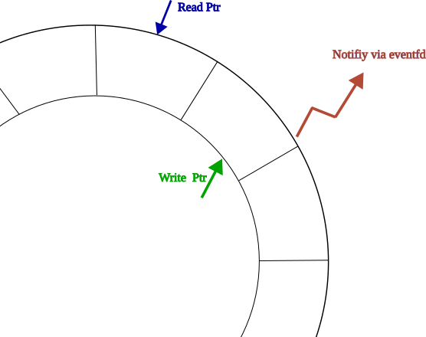
Runtime Data Flow (Fast Path)
Producer App
  Write Message to SPSC Queue
  Notify eventfd
SafetyGuard
  epoll wakeup
  Identify source app
  Dequeue all messages
  Process health / metrics / errors
Work in Progress - License: CC-BY-4.0

Slide 14
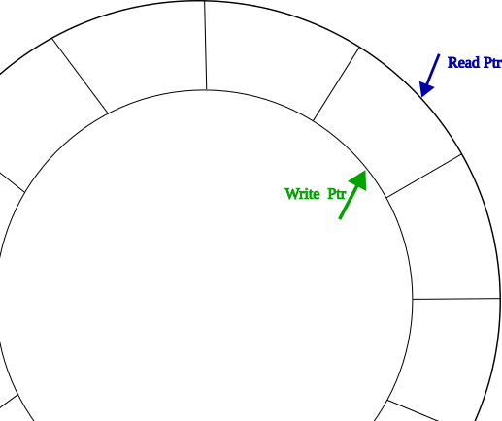
Runtime Data Flow (Fast Path)
Producer App
  Write Message to SPSC Queue
  Notify eventfd
SafetyGuard
  epoll wakeup
  Identify source app
  Dequeue all messages
  Process health / metrics / errors
Reads message, updates the app’s heartbeat details, and metrics
Work in Progress - License: CC-BY-4.0

Slide 15
Runtime Data Flow (Fast Path)
Producer App
  Write Message to SPSC Queue
  Notify eventfd
SafetyGuard
  epoll wakeup
  Identify source app
  Dequeue all messages
  Process health / metrics / errors
Benifits
Zero-copy
No-polling
Per-app isolation
With epoll single thread in safey plane
Work in Progress - License: CC-BY-4.0

Slide 16
Additional Components
Configuration Parser:
Yaml based configuration parser to user defined parameters.
Configuration Parameter generator:
Every system is different.
During development this helps to generate parameters such as heartbeat rate, memory consumption and test safestates
AppManager:
Generic API for managing the application.
Act as interface to existing infrastructure to start, restart or stop Application.
For example:
  Systemd based AppManager
  Container based AppManager
  Limited native AppManager.
Work in Progress - License: CC-BY-4.0

Slide 17
Roadmap

Slide 18
Multi-App Scaling Strategy
Rule:
One App = One Queue + One eventfd
Benefits:
Isolation
Fault containment
Clear source ownership
Easy scaling with epoll
Result:
Multiple apps manageable with low overhead (like mosquitto)
Work in Progress - License: CC-BY-4.0

Slide 19
Deployment Strategy
meta-elisa:
Bitbake-class for inheriting dependency
Generic SafetyGuard application
Common imporant system apps patches such as systemd, gRPC, Dbus, Wayland(weston)
meta-elisa-agl:
AGL specific application patches
Reference SafeState and SafeInstrument Apps.
Embedded Linux / Yocto:
SatetyGuard being yet another application, it will get launched by systemd
Journald logging.
Work in Progress - License: CC-BY-4.0

Slide 20
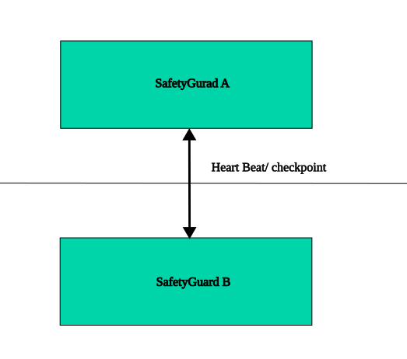
Redundancy Roadmap (Future Safety Expansion)
Dual Monitor (Primary + Secondary)
Cross-monitor heartbeat/checkpoint
Fail-safe state machine
Eg: Xen + dual VM running Linux
Work in Progress - License: CC-BY-4.0

Slide 21
Language-Agnostic API Strategy
Core Runtime
  Rust
Producer Interface
  C library, Interface header files
Supported Apps
  Rust
  C/C++
  And other languages as long as able to write data in shared memory and notify via eventfd.
Principle: “Binary contract over shared memory layout and eventfd notify”
Work in Progress - License: CC-BY-4.0

Slide 22
Security Considerations
Immediate
Socket permission control
App registration validation
Version compatibility
Future
Authentication (Require more inputs, can we do during provision of device?)
Capability restrictions
SELinux/AppArmor
Work in Progress - License: CC-BY-4.0

Slide 23
MVP Proposal
Phase 1 (Immediate)
Single monitor
Dynamic app registration
SPSC + eventfd + epoll
Heartbeat + memory monitoring + restart
Phase 2
Logging + metrics
Support for docker/container engine based applications
C ABI stabilization
Phase 3
Redundancy
Memory partition (Possible via cggroups?)
Work in Progress - License: CC-BY-4.0

Slide 24
Hands-On

Slide 25
Licensing of Workshop Results
All work created during the workshop is licensed under Creative Commons Attribution 4.0 International (CC-BY-4.0) [https://creativecommons.org/licenses/by/4.0/] by default, or under another suitable open-source license, e.g., GPL-2.0 for kernel code contributions.
You are free to:
Share — copy and redistribute the material in any medium or format
Adapt — remix, transform, and build upon the material for any purpose, even commercially.
The licensor cannot revoke these freedoms as long as you follow the license terms.
Under the following terms:
Attribution — You must give appropriate credit, provide a link to the license, and indicate if changes were made. You may do so in any reasonable manner, but not in any way that suggests the licensor endorses you or your use.
No additional restrictions — You may not apply legal terms or technological measures that legally restrict others from doing anything the license permits.
Work in Progress - License: CC-BY-4.0

